Slide 1


Road Sign, State and Notification App - SafeWaka
TASK 4: SYSTEM DESIGN AND MODELLING
By Group 4

Slide 2
Outline
Introduction
System Architecture
Class diagram
Context diagram
Deployment diagram
Use case diagram
Sequence diagram
Conclusion

Slide 3

Client-Server Architecture
Data Sources
External data sources, such as traffic data providers, map APIs, and road sign databases, that supply the necessary information for the app.
Mobile App
The user-facing application that provides the core functionalities and user interface.
1
2
3
Backend Server
The server-side component responsible for data collection, processing, and storage.

Slide 4
MODEL VIEW PRESENTER
MODEL
PRESENTER
1
2
3
VIEW

Slide 5
Structural Diagrams
1
Class Diagram
2
Context Diagram
3
Deployment Diagram
Depicts the structure of the system by showing the classes, their attributes, operations, and relationships.
Provides an overview of the system's interactions with internal and external entities, showcasing the data flows and system boundaries.
Represents the physical deployment of software components on hardware nodes, illustrating how artifacts are allocated to different nodes.

Slide 6

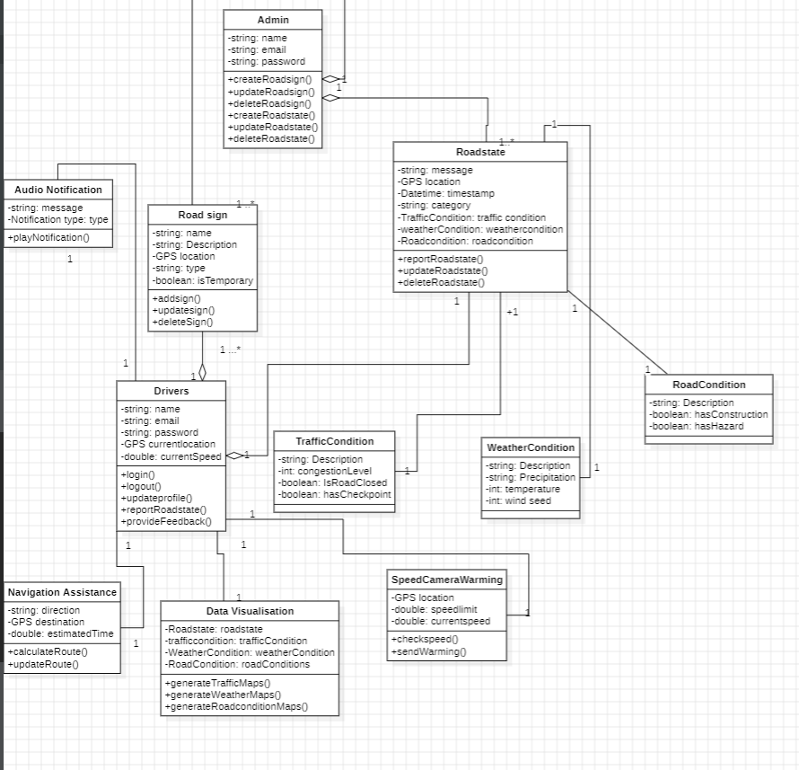
Class Diagram

Slide 7
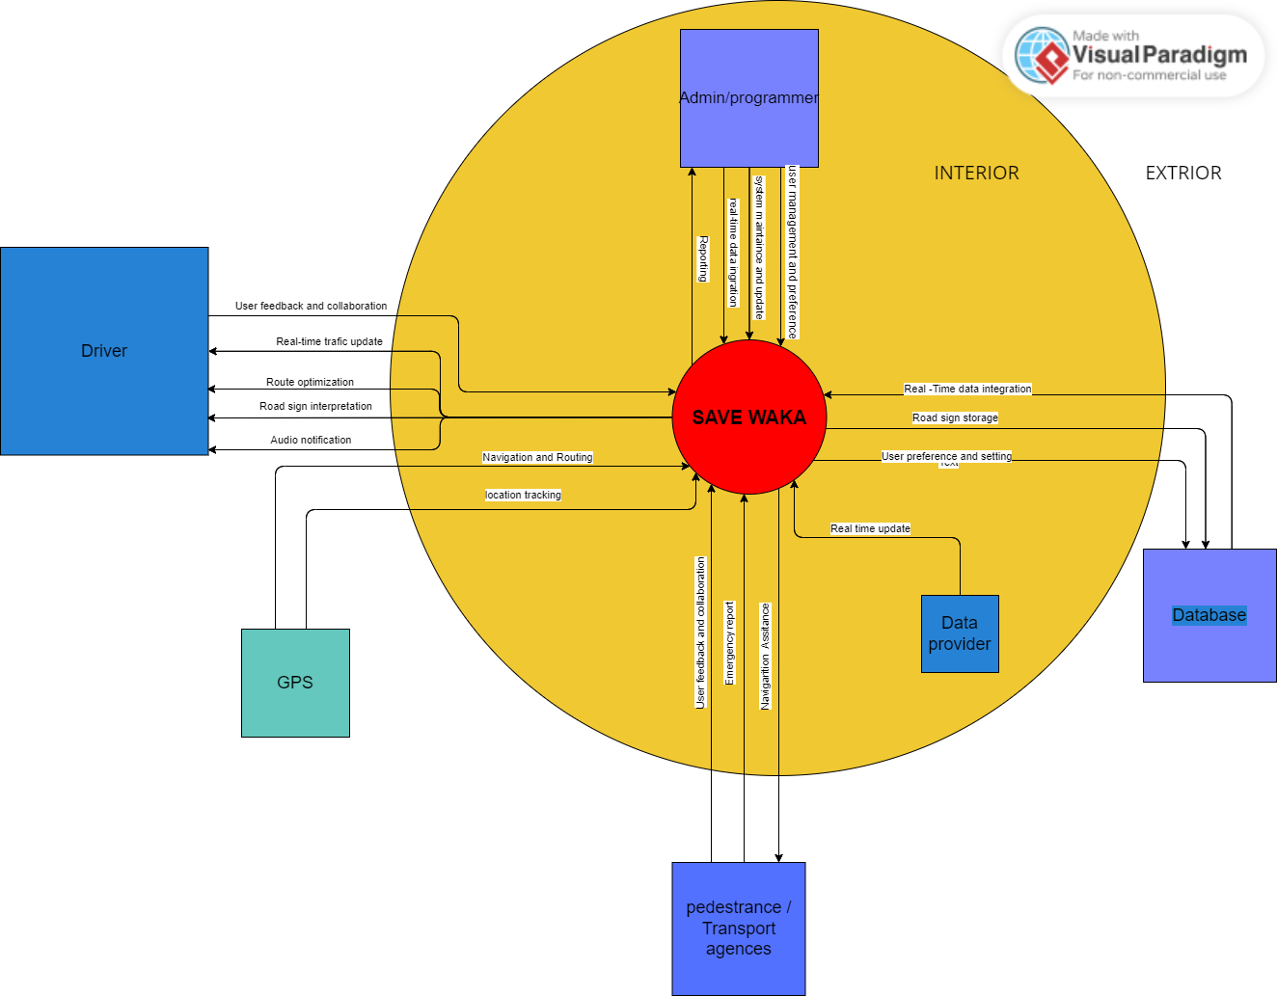
Context Diagram

Slide 8
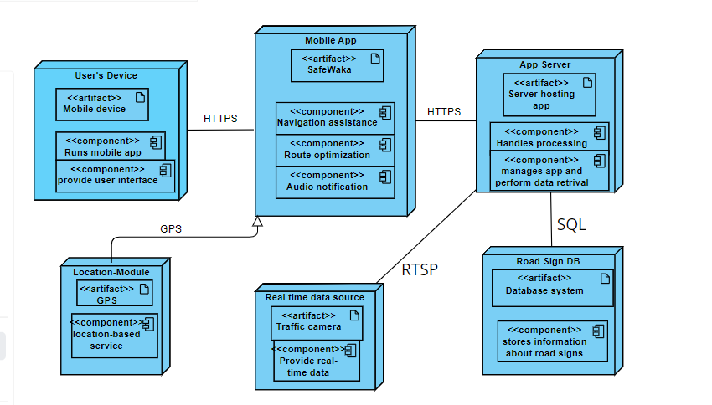
Deployment Diagram

Slide 9
Behavioral Diagrams
Use Case Diagram
Sequence Diagram
Illustrates the interactions between actors (users or external systems) and the system, showcasing the different use cases or functionalities provided by the app.
Models the interactions between objects or components within the system, providing insights into the collaboration and communication patterns.

Slide 10
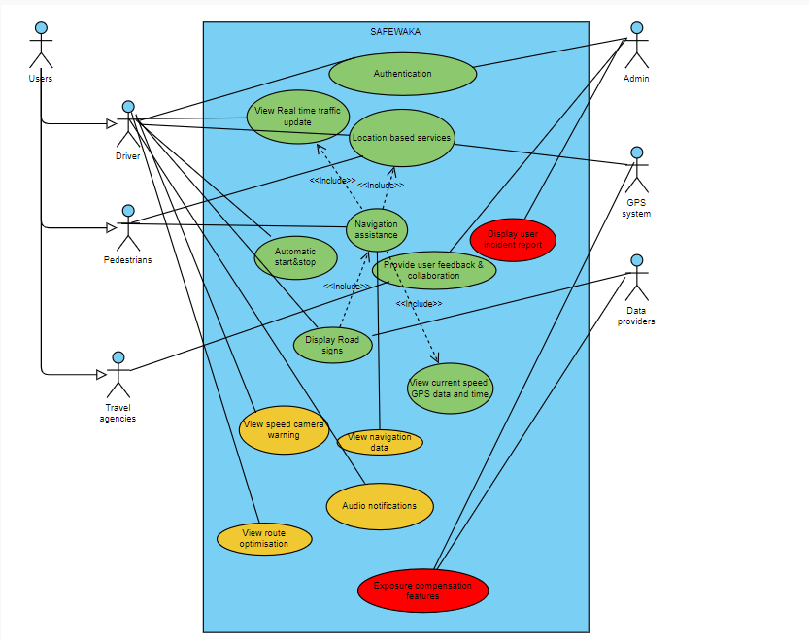
Use Case Diagram

Slide 11
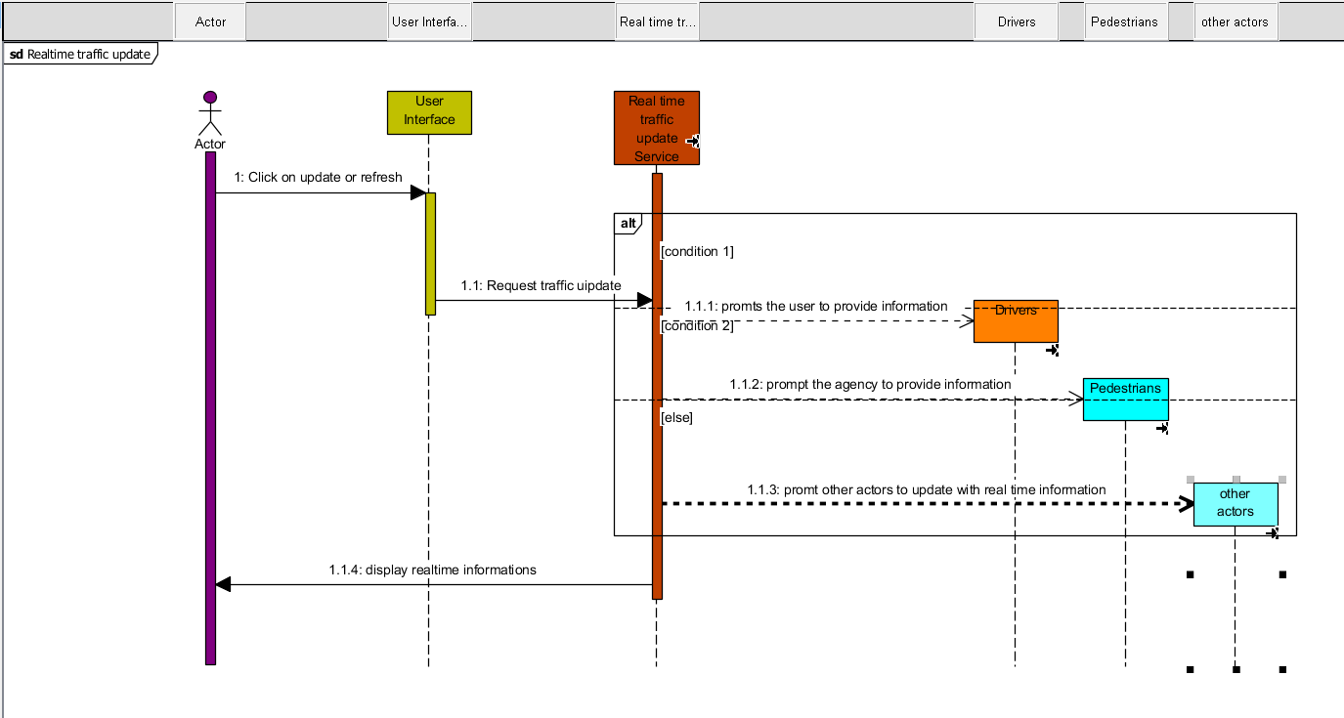
Sequence Diagrams
Sequence Diagram 1: Get Real Time Traffic updates

Slide 12
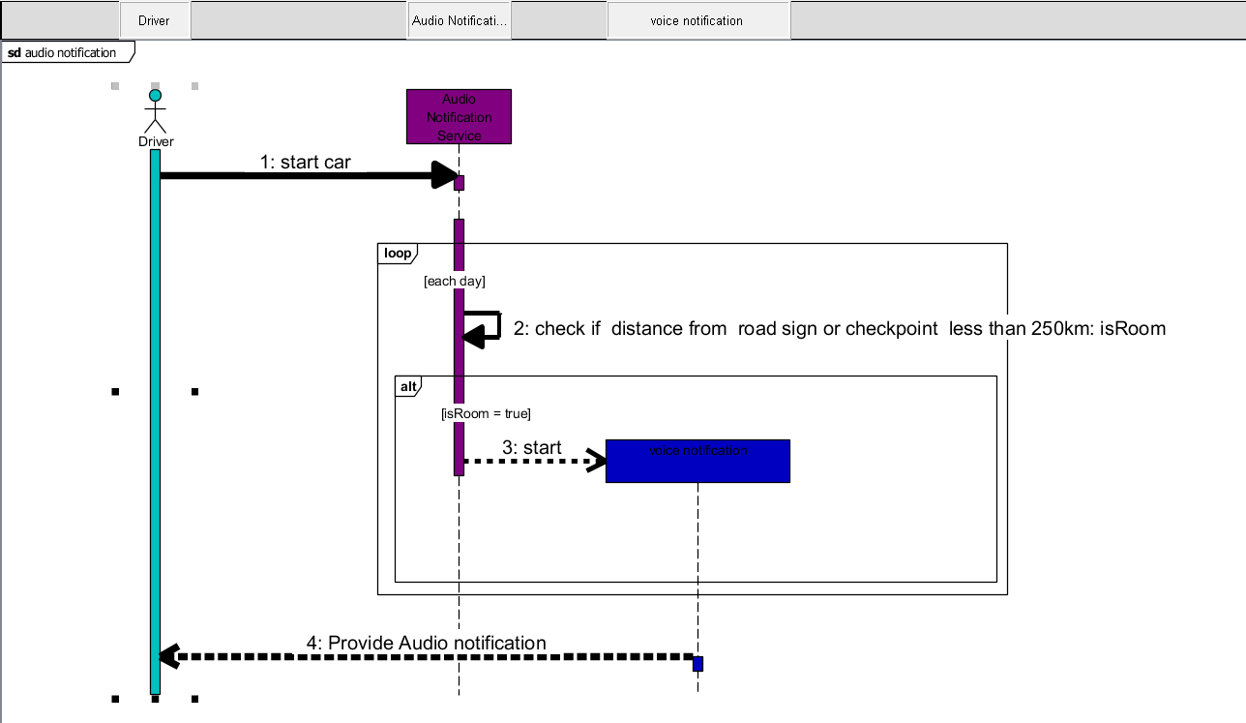
Sequence Diagrams
Sequence Diagram 1: Get Real Time Traffic updates
Sequence Diagram 2: Audio notifications

Slide 13
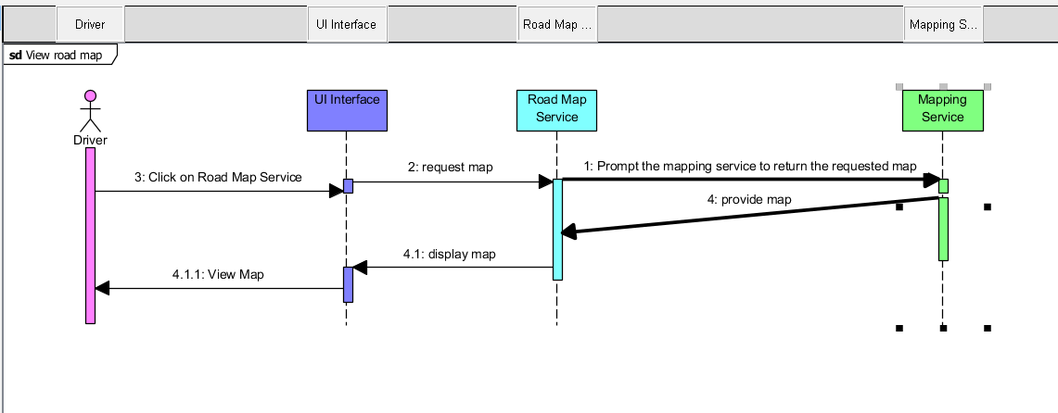
Sequence Diagrams
Sequence Diagram 1: Get Real Time Traffic updates
Sequence Diagram 2: Audio notifications
Sequence Diagram 3: View road map

Slide 14
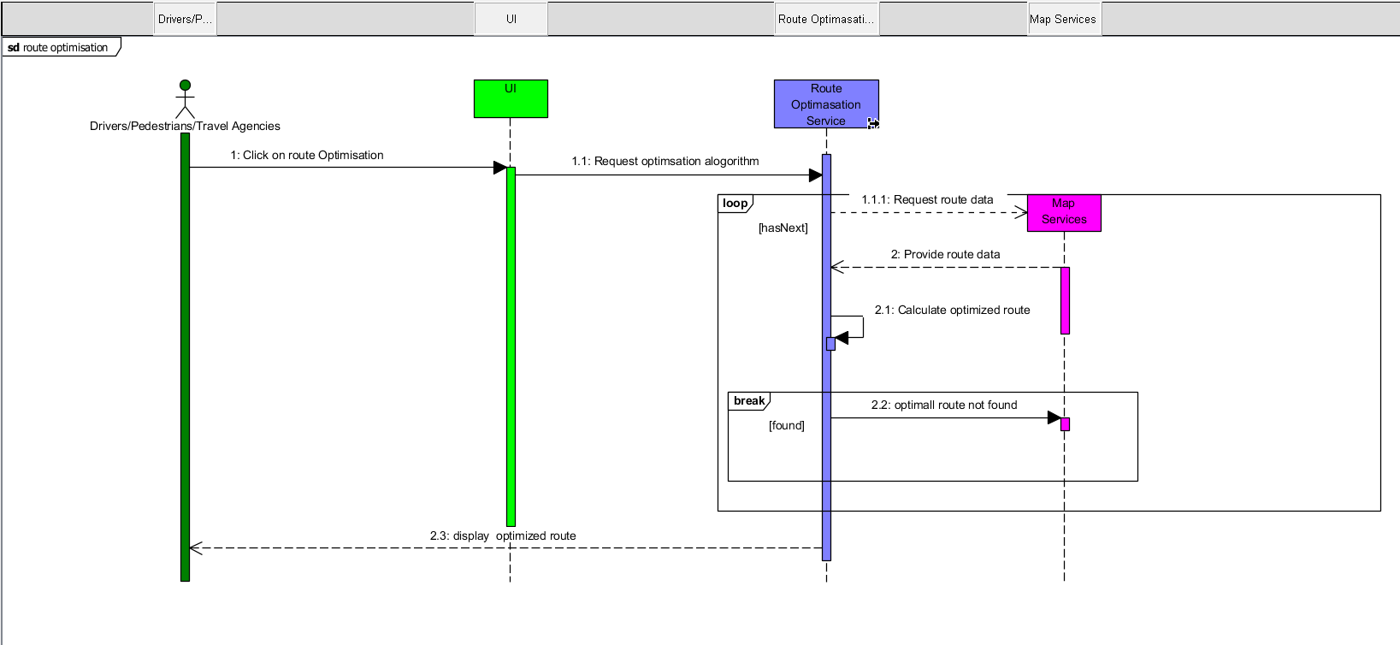
Sequence Diagrams
Sequence Diagram 1: Get Real Time Traffic updates
Sequence Diagram 2: Audio notifications
Sequence Diagram 3: View road map
Sequence Diagram 4: Route optimisation

Slide 15
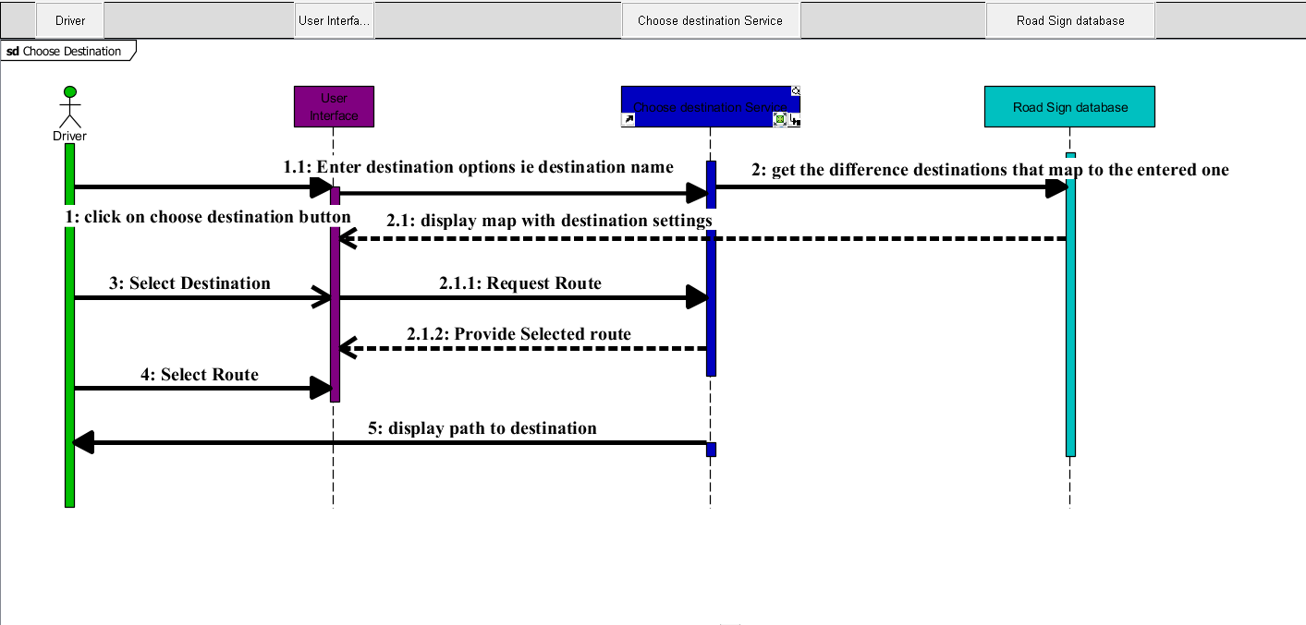
Sequence Diagrams
Sequence Diagram 1: Get Real Time Traffic updates
Sequence Diagram 2: Audio notifications
Sequence Diagram 3: View road map
Sequence Diagram 4: Route optimisation
Sequence Diagram 5: Choose Destination

Slide 16
Conclusion
In summary, the comprehensive use of structural, behavioral
and interaction diagrams has been crucial in designing and
documenting the road sign, road state, and notification app.

Slide 17
THANK YOU ☺

